Slide 1
Empirical cost of community mobilization activities to support the scale-up of Universal Test and Treat in Eswatini
Shaukat Khan
Wednesday 25 July 2018
International AIDS Conference 2018, Amsterdam
Shaukat Khan, Cebele Wong, Tenele Maziya, Fiona Walsh, Charlotte Lejeune, Yvette Fleming, Gavin Khumalo, Mandisa Zwane, Velephi Okello, Till Bärnighausen

Slide 2
No conflict of interest to disclose

Slide 3

Introduction to the MaxART consortium
MoH/SNAP, SWANNEPHA, GNP+, Aidsfonds, CHAI, SAfAIDS, SACEMA, UvA
Source: HIV Annual Report, 2016

Slide 4
Historically, community mobilization costs have not been well understood
Rationale
What are the community mobilization cost of implementing universal test and treat in a “real world” setting?
Comprehensive costing data from MaxART community partners:
  Swaziland National Network of People Living with HIV/AIDS (SWANNEPHA)
  Southern African AIDS Information Dissemination Service (SAfAIDS)
Activities included in costing
  General orientation
  Media orientation
  Information, Education and Communication Materials (IEC)
  Community Mobilization Events
  M&E activities
  Community Advisory Board
Methodology

Slide 5
Community mobilization activities such as community dialogues and distribution of IEC materials occurred at all stages of the study
Sept 2014
Aug 2017
Orientation
Community Dialogues
Information, Education and Communication (IEC) material
Monitoring and Evaluation

Slide 6
71% of total cost was in support of community mobilization events
Total Cost= $69,234

Slide 7
Cost of targeted community dialogue was $336 per event compared to $650 for general dialogues
Events | Number of events | Mean cost per event (USD) (STDEV)
Community Mobilization Events | 212 | 231 (245)
Community Dialogue – general | 18 | 650 (538)
Community Dialogue – targeted | 35 | 336 (209)
Dialogues with Existing Community Resource Groups (CRGS) | 44 | 216 (143)
Dialogues with PLHIV | 85 | 138 (80)
General Community Dialogues
  Demand creation through community mobilization
  Mass sensitization of communities
Targeted Community Dialogues
  Targeting of special groups including:
    Women of reproductive age (18-24)
    Men (30yrs or older)
    Sex workers

Slide 8
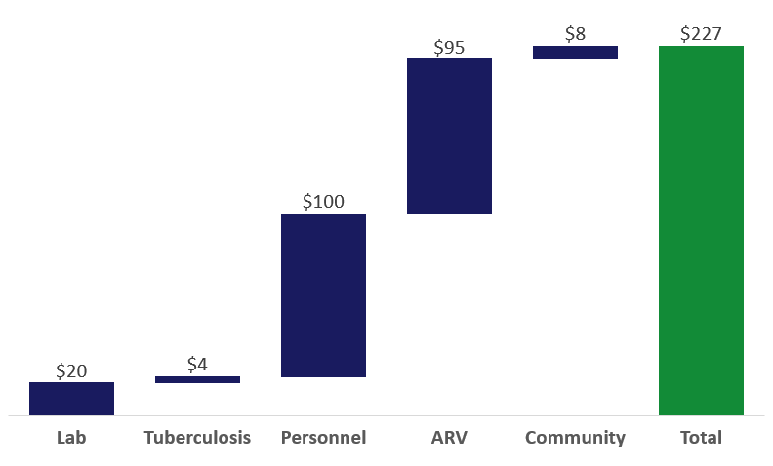
Community activities add only 4% additional cost to ART clients

Slide 9
Conclusions
Per-patient costs are marginal relative to treatment costs
Largest category was community mobilization
Effectiveness of community mobilization is still critical knowledge gap

